Slide 1
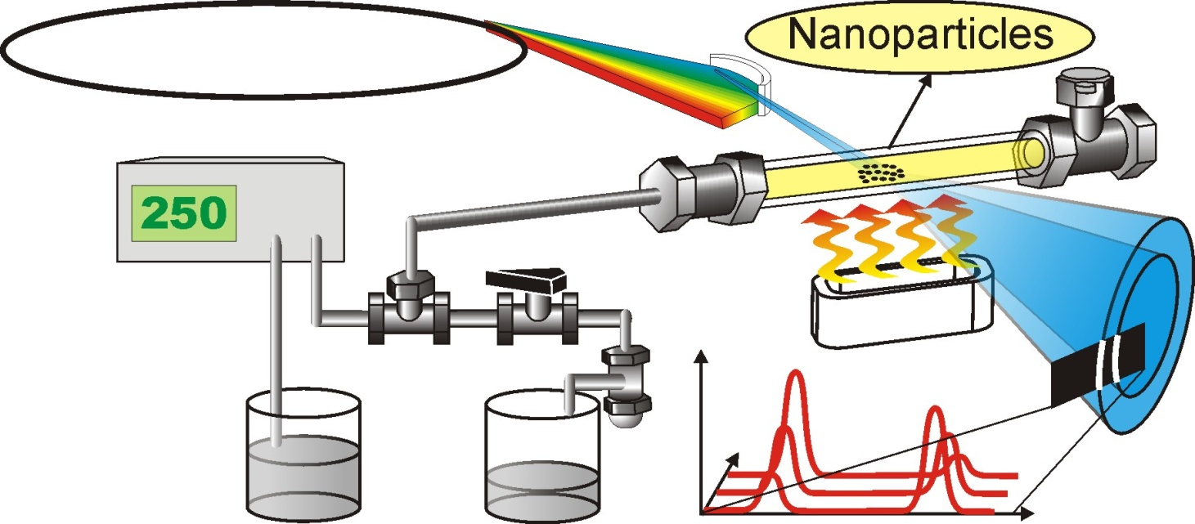
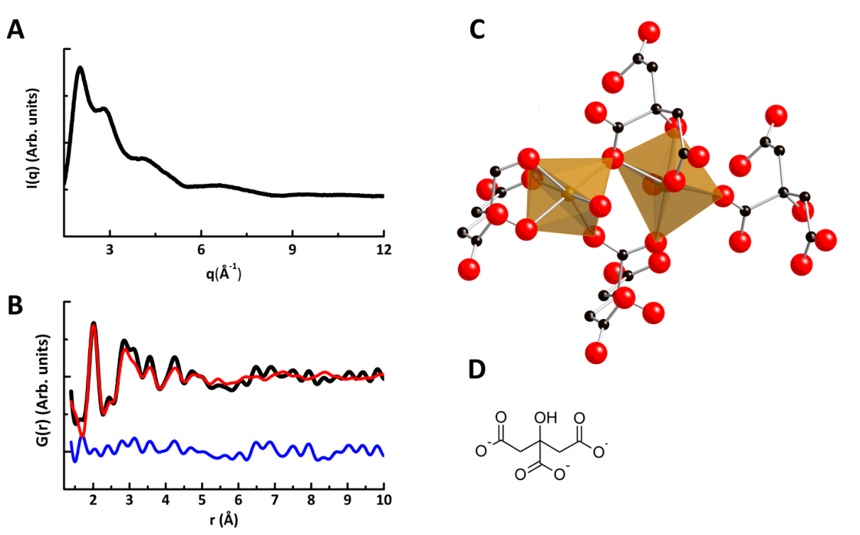
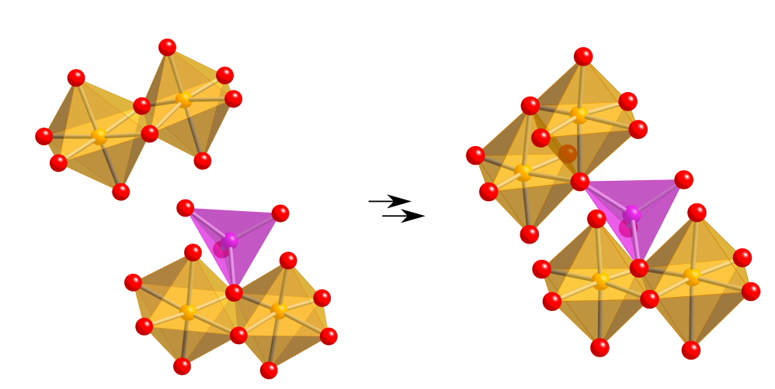
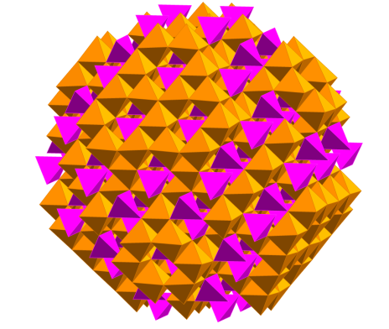
Applications of principal component analysis to pair distribution function Karena W. Chapman, Saul H. Lapidus and Peter J. Chupas
Why do we do pair distribution function analysis
How does we use PCA on pair distribution function data?
What is principal component analysis
doi:10.1107/S1600576715016532

Slide 2
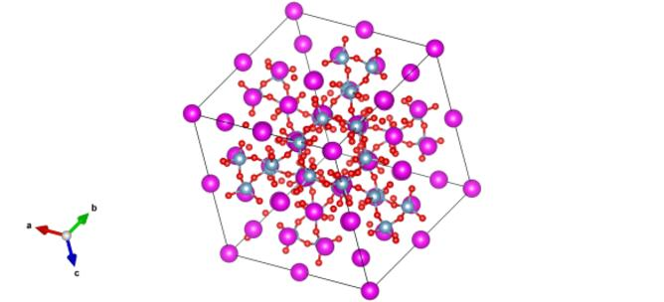
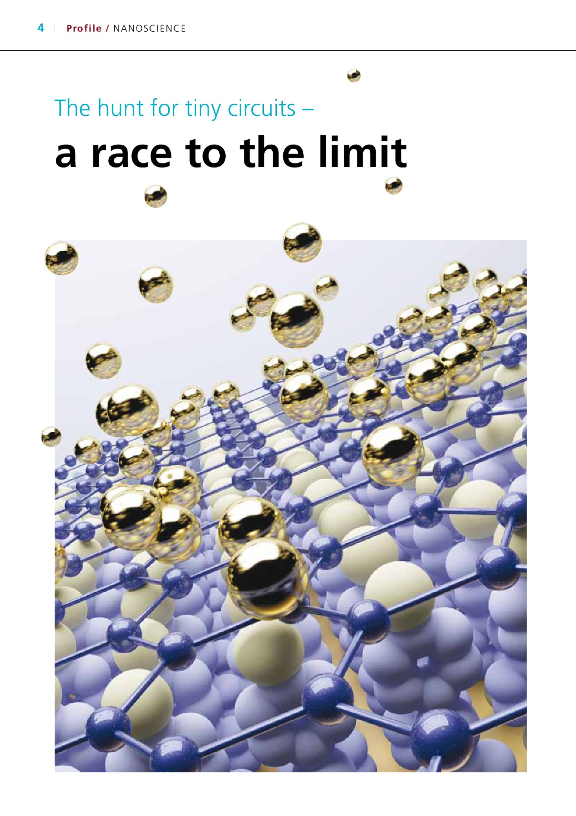
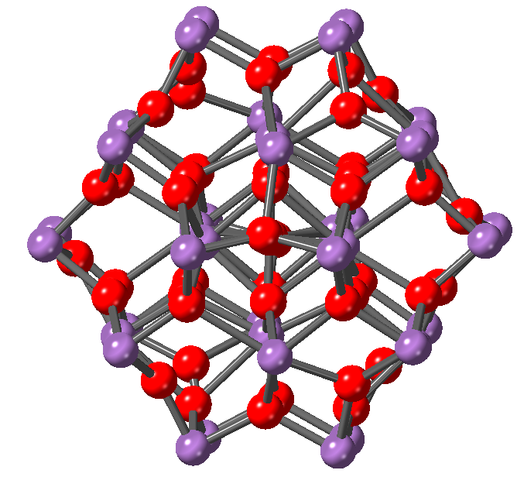
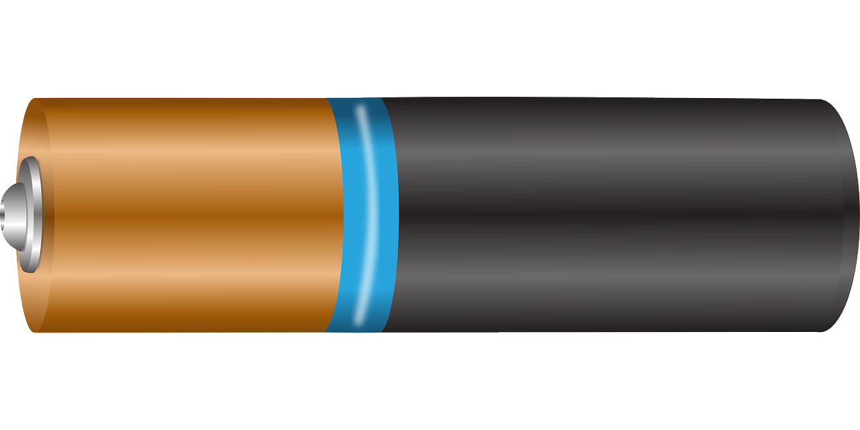

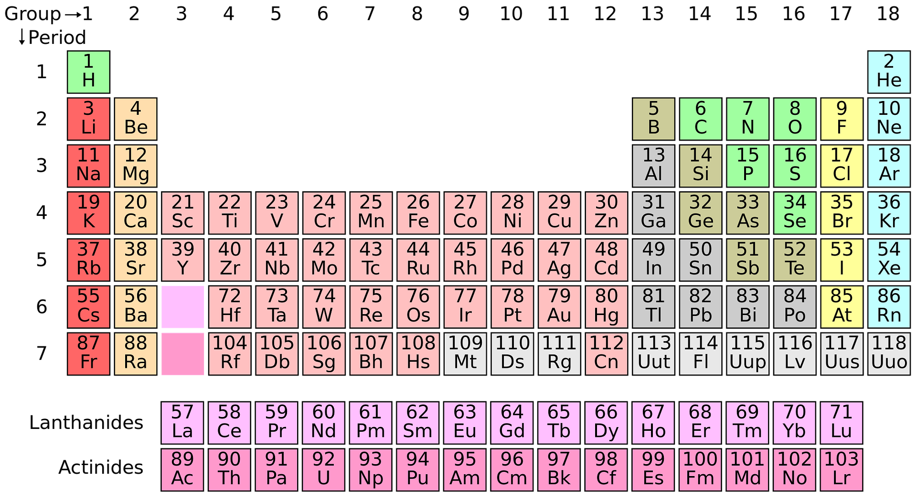
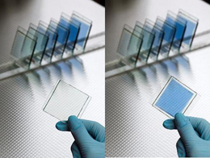
The Holy Grail of Materials Chemistry
Structure
Synthesis
Properties

Slide 3


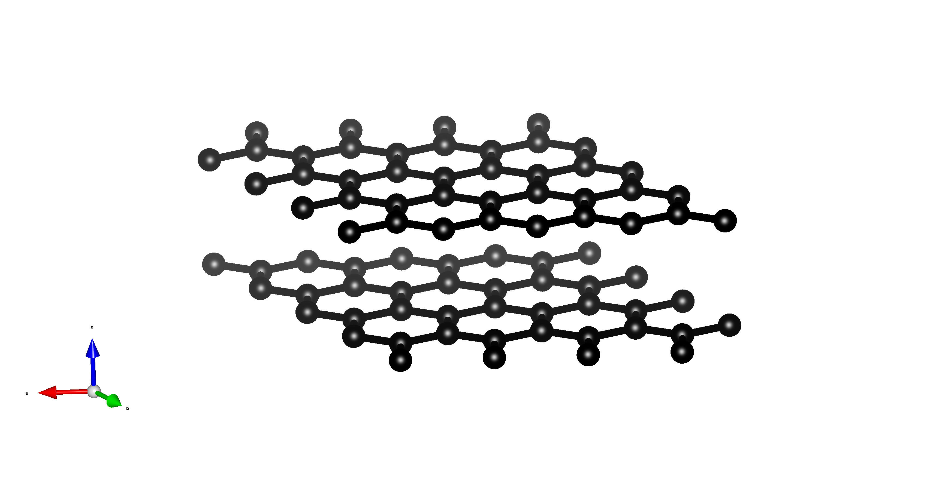
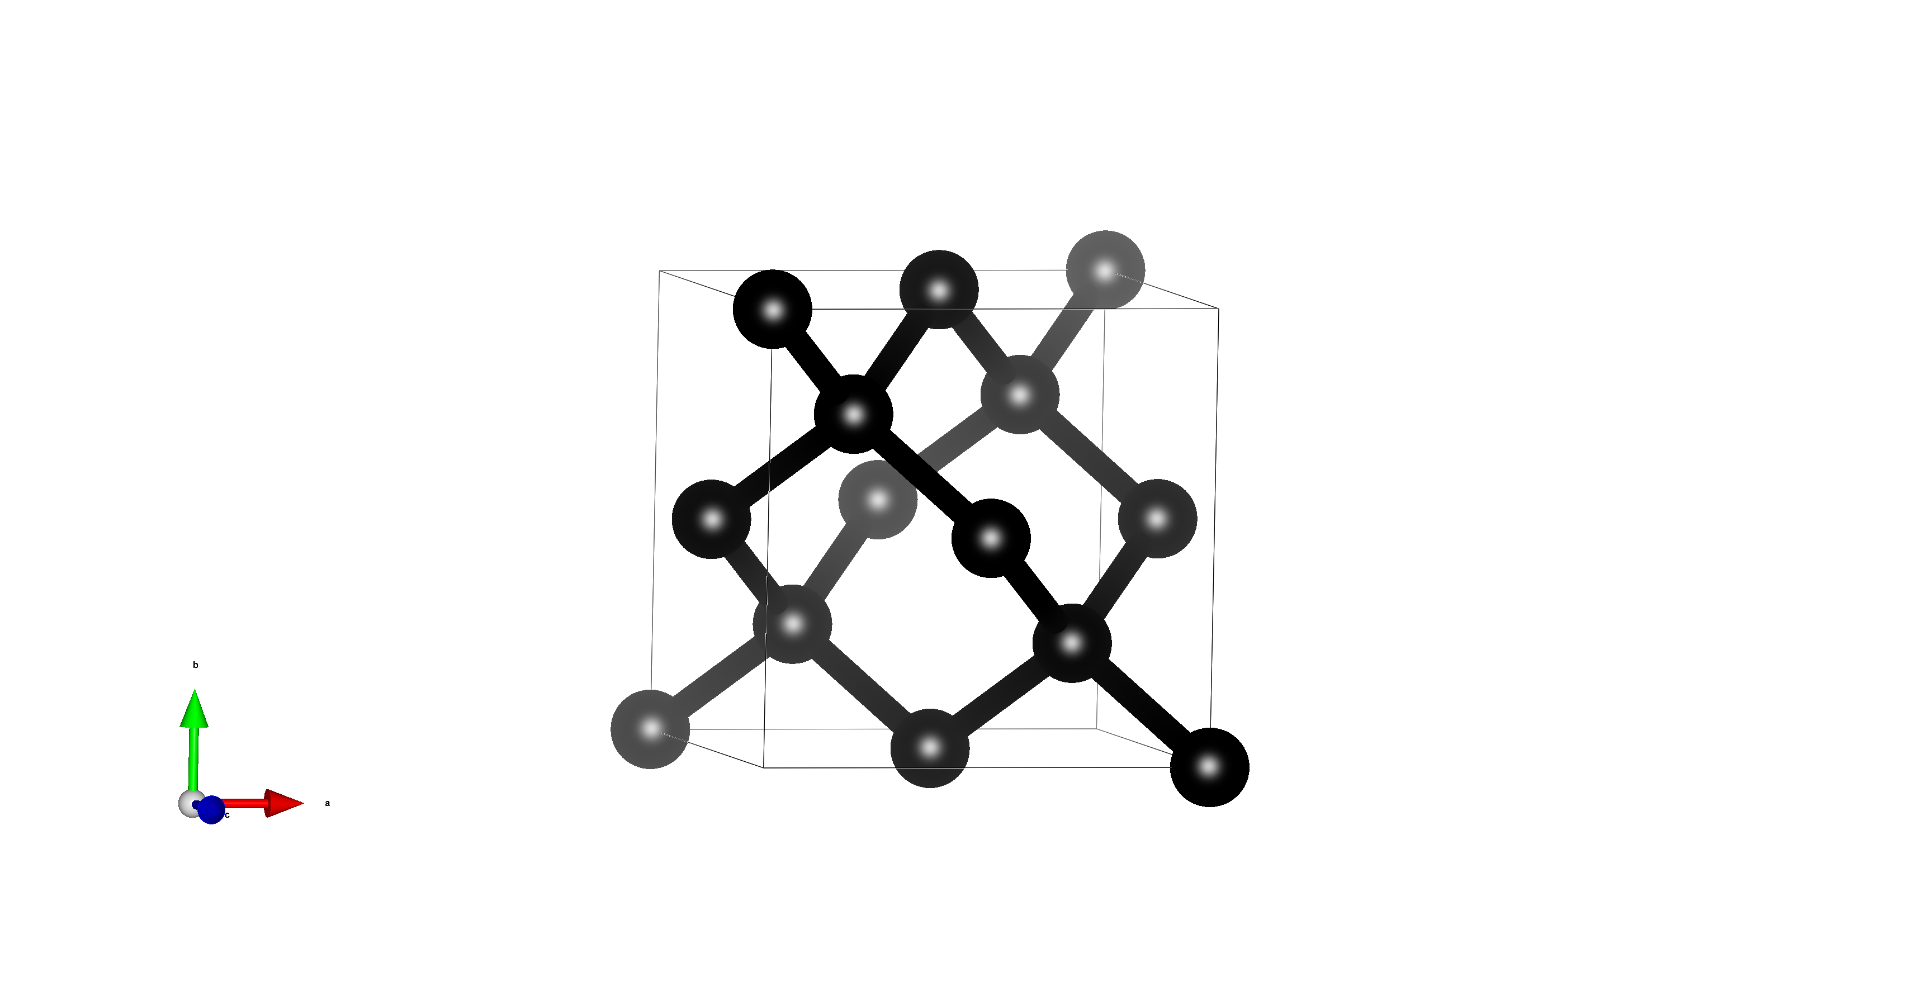
Properties and structure are directly connected

Slide 4
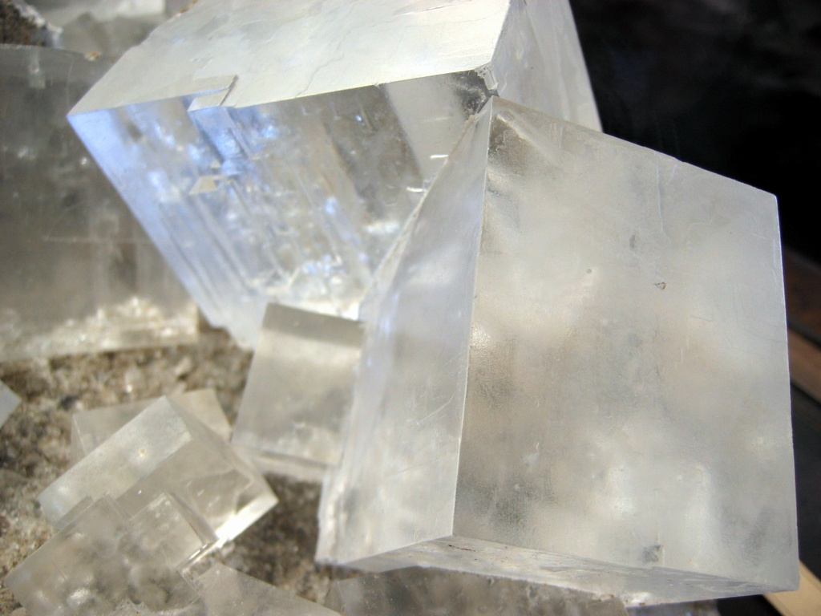
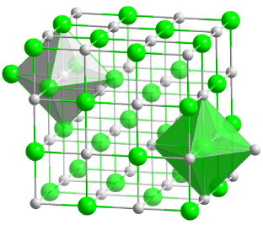
X-ray diffraction from bulk materials
X-ray diffraction
Structure solution
Constructive interference due to periodicity
Notes:
Forklar der kun bruges bragg peaks

Slide 5

New possibilities with 3rd generation synchrotron and high energy neutron facilities
All classes of materials
Amorphous, nanostructured and crystalline
Liquids or solids
But it takes a long time to model the data!
High energy
High X-ray flux!
More signal!
Lots of data!

Slide 6
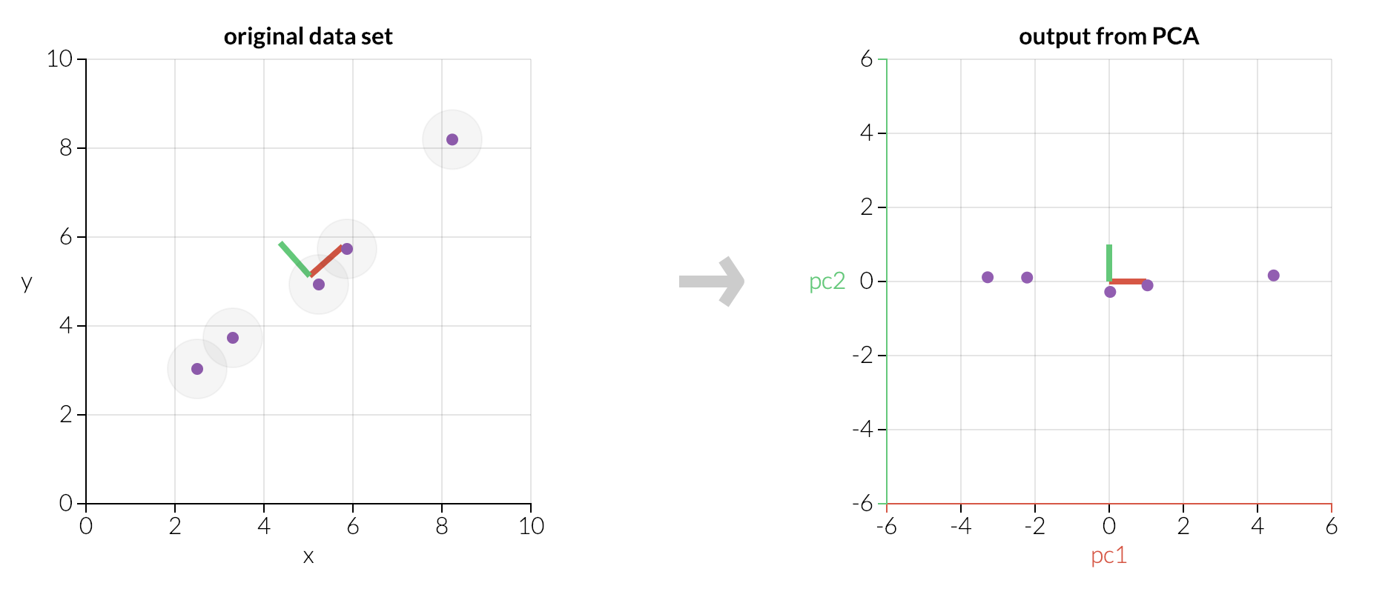
Principal Component Analysis in 2 dimensions
2 linear regressions
Scaling – difficulties with chemical systems??
Information in the PC’s
http://setosa.io/ev/principal-component-analysis/
Notes:
2D data, we make 2 linear regressions.
We scale the data.
We can drop PC2 since it does not contribute much to the data.

Slide 7
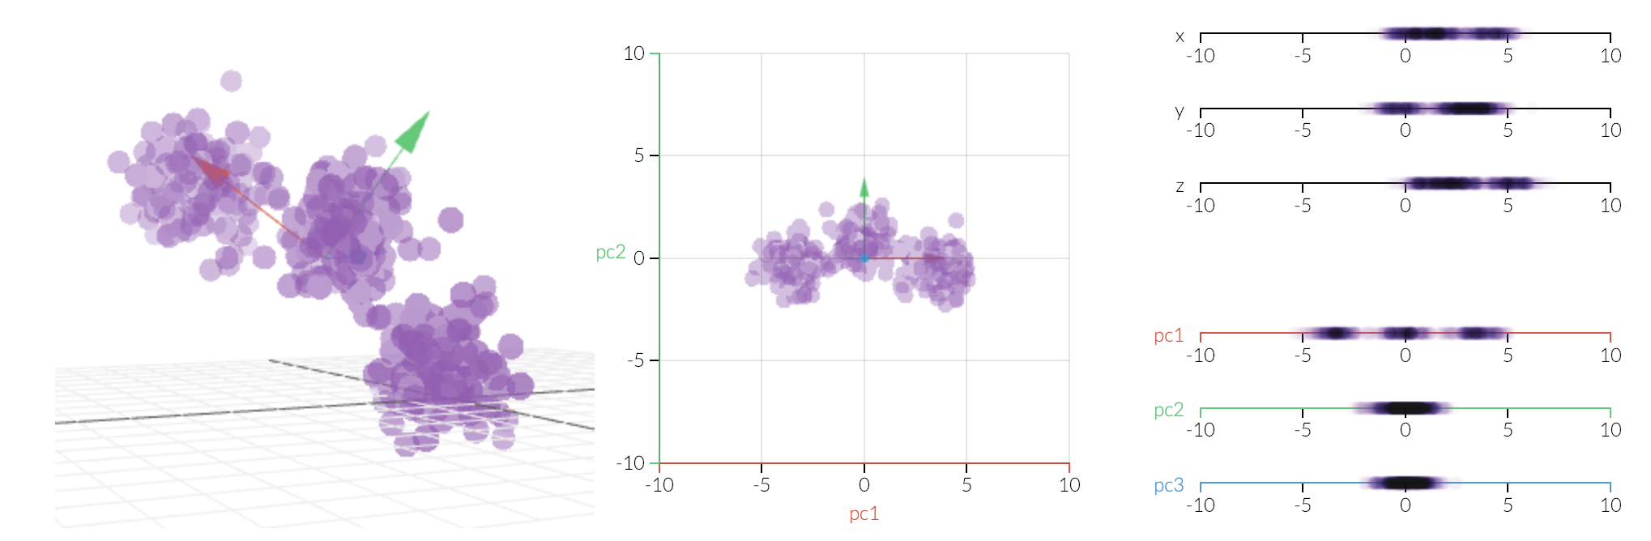
Principal Component Analysis in 3 dimensions
3D visualization Projected to 2D Projected to 1D
3 linear regressions
Difficult to visualize multiple dimensions
Clustering
Robustness with pair distribution function data
http://setosa.io/ev/principal-component-analysis/

Slide 8
PCA Scree plot
How many PC’s describes the data?
How much information in the PC?
doi:10.1107/S1600576715016532

Slide 9
Principal Components plot
How does the PC look like?
Are they physical?
Does a structure relate to 1 or multiple PC’s?
doi:10.1107/S1600576715016532

Slide 10
Ratio of Principal Components
How does the ratio of PC’s change during the reaction?
RuO₂ → Li_{X}RuO₂ → Ru + Li₂O
doi:10.1107/S1600576715016532

Slide 11
Conclusion: Principal component analysis to pair distribution function
Modelling of PDF data by conventional techniques are time-consuming.
PCA on pair distribution function data is fast.
PCA does not need any prior knowledge (bias) of the chemical structure.
PCA can identify trends that the human eye cannot – peak overlap, large amounts of data, complicated changes.
This article shows that PCA is efficient in modelling pair distribution function data.

